Slide 1
Predictive Maintenance in the IoT Era
Notes:
Predictive maintenance is a technique to predict when an in-service machine will fail so that maintenance can be planned in advance. These technologies allow companies such as ThyssenKrupp Elevator to go from reactive to proactive and even predictive analysis of maintenance problems; And become a data-driven organization.
Data-driven predictive maintenance, in particular, is gaining increasing attention in the industry along with the emerging demand of the Internet of Things (IoT) applications and the maturity of the supporting technologies. In this session we will present a real-world predictive maintenance example where the problem is formulated into three related questions via different machine learning models. A demonstration of how data flows through an end-to end-system, from ingesting the data to aggregating in real time to predicting based on historical data, will be done using tools such as Azure Machine Learning, Azure Stream Analytics, and Power BI.

Slide 2







Cortana Analytics Suite Transform data into intelligent action
Information Management
Big Data Stores
Machine Learning and Analytics
Dashboards and Visualizations
Business apps
Power BI
Azure
Data Factory
Azure
Machine Learning
Personal Digital Assistant
Azure
Data Lake
Cortana
People
Custom apps
Azure
Data Catalog
Azure
HDInsight (Hadoop)
Perceptual Intelligence
Azure
SQL Data Warehouse
Face, vision
Speech, text
Azure
Event Hub
Azure
Stream Analytics
Business Scenarios
Sensors and devices
Recommendations,
customer churn,
forecasting, etc.
Automated Systems
DATA
INTELLIGENCE
ACTION

Slide 3
Today’s Talk
Information Management
Data Stores
Machine Learning and Analytics
Dashboards and Visualizations
Power BI
Azure
Data Factory
Azure
Machine Learning
Azure
SQL Database
People
Azure
Event Hub
Azure
Stream Analytics
Business Scenarios
Sensors and devices
Maintenance scheduling, parts ordering…
Automated Systems
DATA
INTELLIGENCE
ACTION
Notes:
I’ll be talking about IoT related to bringing data right off of devices, using tools like:
1. ADF and event hubs to read in data and orchestrate data movements
2. Azure SQL DB to store information about machine states
3. Azure ML to predict how much time a machine has
4. Stream Analytics to process the data in real time
5. Visualization layer and then acting upon the results

Slide 4
Outline
Predictive Maintenance Use Cases
Building E2E solution with Cortana Analytics Suite
Data
Modeling, Evaluation
Notes:
Predictive maintenance use cases sound straight forward, but it is actually much more than meets the eye.
Solution Templates are designed to accelerate the process of building an E2E demo on top of Cortana Intelligence Suite. A deployed template will provision your subscription with necessary Cortana Intelligence components and build the relationships between them. It also seeds the data pipeline with sample data generated from a data generator application which you will download and install on your local machine after you deploy the solution template. The data generated from the generator will hydrate the data pipeline and start generating machine learning predictions which can then be visualized on the Power BI dashboard. The deployment process will guide you through several steps to set up your solution credentials. Make sure you record these credentials such as solution name, username, and password you provide during the deployment.

Slide 5
Predictive Maintenance Concepts
Important task in Internet of Things applications
Goal: improve production/maintenance efficiency
 | Predictive Maintenance in IoT | Traditional Predicative Maintenance
Goal | Improve production and/or maintenance efficiency | Ensure the reliability of machine operation
Data | Data stream (time varying features), Multiple data sources | Very limited time varying features
Scope | Component level, System level | Parts level
Approach | Data driven | Model driven
Tasks | Failure prediction, fault/failure detection & diagnosis, maintenance actions recommendation, etc. Essentially any task that improves production/maintenance efficiency | Failure prediction (prognosis), fault/failure detection & diagnosis (diagnosis)
Notes:
Smarter Maintenance:
Traditionally, we go to get an oil change based on time (how many months),
instead of how the usage is effecting the device or thing. Do maintenance based on that instead.
With IoT, we have data streams with time varying features. Which is different than the kind of data we had in the past.
We will be focusing on a data-driven approach, doing tasks like …

Slide 6

Predictive Maintenance Use Cases
Aerospace
Utilities
Manufacturing
Transportation & Logistics
What is the likelihood of delay due to mechanical issues?
When is my solar panel or wind turbine going to fail next?
Will the component pass the next stage of testing on factory floor or do I need to rework?
Should I replace the break disks in my car or can I wait for another month?
When is this aircraft component likely to fail next?
Which circuit breakers in my system are likely to fail in the next month?
What is the root cause of the test failure?
What maintenance task should I perform on my elevator?
Is the ATM going to dispense the next 5 notes without failing?

Slide 7
Aircraft Engine Demo

Slide 8
Scenario
This is Kyle.
Kyle manages a team that maintains aircrafts.
His job is to make sure that his 100 aircrafts are running properly & especially that the aircraft engines don’t need service.
Kyle wants to prevent delays due to mechanical issues so his customers will be happy.

Slide 9
Scenario
Sadly, engines occasionally show signs of problems & must be taken out of service for maintenance or replacement.
To eliminate this occurrence, Kyle must maintain operations & figure out the best way to utilize resources in order to minimize delays due to mechanical issues.
Notes:
Engines may be close to the end of the life cycle

Slide 10
Questions & Solutions
Cortana Analytics to the Rescue!
1. How long did engines run in the past?
2. Which are showing signs of failure?
3. Which engines are likely to fail in the future?
Notes:
We are trying to predict the Remaining Useful Life of the machine / asset.
You can predict the risk of failure as well if you wanted in a different model

Slide 11
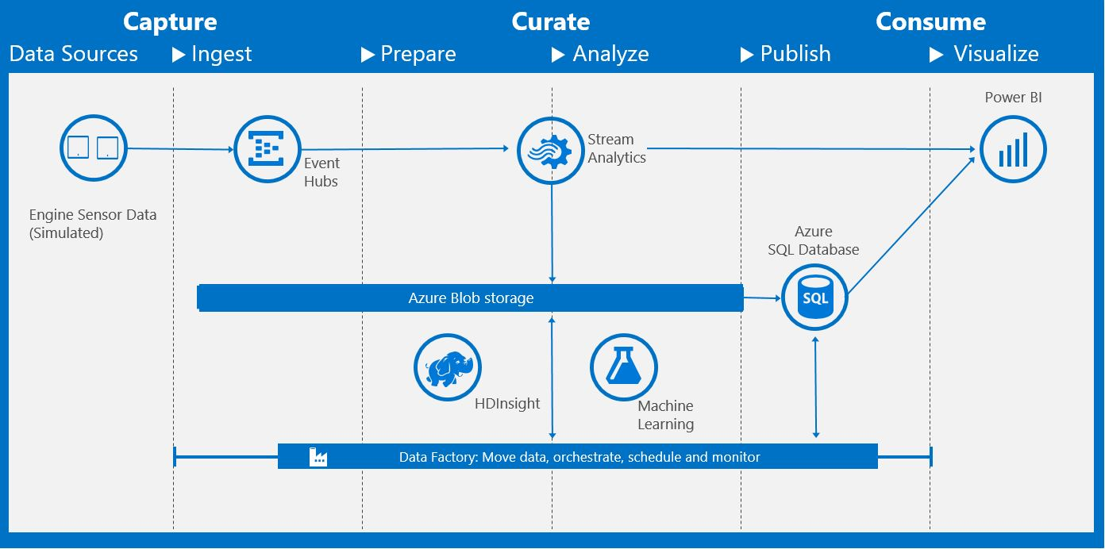

Components
Training Data:
Aircraft engine run to failure data from NASA Ames Prognostics Data Repository
Azure
Blob Storage
2
Azure
Machine Learning Batch API
3
1 4
Azure
Data Factory
Aircraft engine real-time data based on NASA Ames Prognostics Data Repository
Azure
Event Hub
Azure
Stream Analytics
Azure
SQL Database
Real-time
Batch updates
Power BI
Notes:
We use publicly available data here, so you can reproduce this yourself if you wanted
We take data from the NASA data repository using the Turbofan Engine Degradation Simulation Data Set.
NASA has published this aircraft engine run-to-failure data (, and we train a machine learning model on it.
We then use that data to predict based on the stream of data we send in.
So basically we have this training data from NASA and then we stream in data simulating the aircraft’s running.
Aggregate - over the fleet; not just 1 aircraft. (So on the dashboard when we see “Real time monitoring of sensor 12”, you can see we take an average of that over time of the whole fleet.)
ADF: Consuming the ML Model using ADF. Data is pushed into SQL DB orchestrated or moved through ADF. That
But we maintain the granularity at the 1 flight level through aggregations using simple SQL queries
done in Azure data factory to do some feature engineering
(do things like look at Standard Dev, not just avg),
calls out to the ML model and put the results back in SQL DB.
ADF Runs every 15 mins, in the demo it’s coming once every second – we speed it up in the demo
------------------------------------------------------------------------
Technical details and workflow
The simulation data is streamed by a newly deployed Azure Web Job, AeroDataGenerator.
This synthetic data feeds into the Azure Event Hubs service as data points.
Two Azure Stream Analytics jobs analyze the data to provide near real-time analytics on the input stream from the event hub. One of the Stream Analytics jobs archives all raw incoming events to the Azure Storage service for later processing by the Azure Data Factory service, and the other publishes results onto a Power BI dashboard.
The HDInsight service is used to run Hive scripts (orchestrated by Azure Data Factory) to provide aggregations on the raw events that were archived by the aforementioned Stream Analytics job.
The Azure Machine Learning service is used (orchestrated by Azure Data Factory) to make predictions on the remaining useful life (RUL) of particular aircraft engine given the inputs received.
Azure SQL Database is used (managed by Azure Data Factory) to store the prediction results received from the Azure Machine Learning service. These results are then consumed in the Power BI dashboard. A stored procedure is deployed in the SQL Database and later invoked in Azure Data Factory pipeline to store the ML prediction results into the scoring result table.
Azure Data Factory handles orchestration, scheduling, and monitoring of the batch processing pipeline.
Finally, Power BI is used for results visualization, so that aircraft technicians can monitor the sensor data from an airplane or across the fleet in real time and use visualizations to schedule engine maintenance.

Slide 12
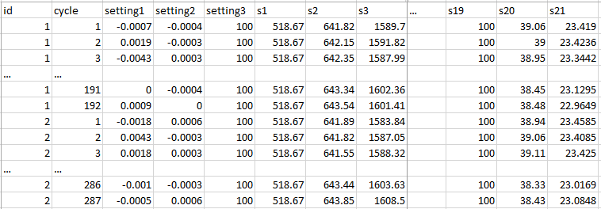
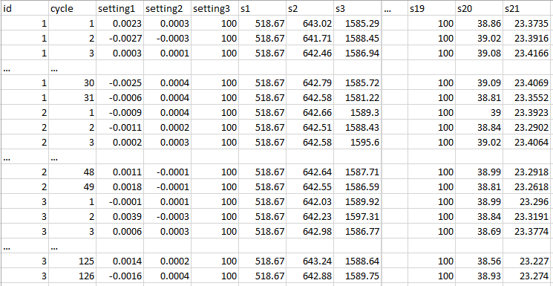

Sample training data
~20k rows,
100 unique engine id
Sample testing data
~13k rows,
100 unique engine id
Sample ground truth data
Please refer to following link of doc for Data description section
100 rows
Notes:
1 row per flight
Id – of the aircraft
Cycle - flight number
S= sensor
Run to failure data – all the engines had failed at the end
This was a lab environment where they had simulated how the engines would work and pushing them to the limits until the engine failed.
That’s an important concept because it allows us to create the labels for our experiment, for our ML model to learn what the relationship is between the sensors and how much the RUL is of that aircraft engines.
The middle column in the ML experiment is the Test Data.
The key difference is that these engines were NOT Run to Failure
And we don’t know how many cycles they have.
And that’s why we have this ground truth file,
which tells us for the engines in the test data set, when did they actually fail?

Slide 13
Conclusion
With the visualization prowess of Power BI, business owners can easily examine the performance of their entire company.
Kyle is a happy man!
The Internet of Things and Stream Analytics connect data directly from the source to a dashboard to constantly track anomalies and asset performance in real-time.
Azure Machine Learning catches the problem before it becomes a problem. It streamlines operations without wasting resources.

Slide 14
Is the problem ready for ML?
The better the raw materials, the better the product.
Question is sharp.
Data measures what they care about.
Data is accurate.
Data is connected.
A lot of data.
E.g. Predict whether component X will fail in the next Y days
E.g. Identifiers at the level they are predicting
E.g. Failures are really failures, human labels on root causes
E.g. Machine information linkable to usage information
E.g. Will be difficult to predict failure accurately with few examples
Notes:
Data measures what they care about:
Sensor values about the aircraft but no data about the components.
Some of the Best ML data sets that we have worked with have been:
On a MFG floor there is an automated test that says this is likely to fail or not based on some thresholds it has and domain context
Next human goes in to check yes that was really a failure – having human labels are very helpful! The ML model will only learn based on the data you give it
Data is connected:
Linkable data sets:
You wanna have the sensor values and the components along with how they are related. Seems straight forward but its important.
The more failures you have the better data you have to build a ML model.
We are predicting the indicator before the failures, not the actual failure itself.
Use maintenance data: person goes out and sees the equipment is degrading. Use it.

Slide 15
Qualification Criteria
For ML-based solution:
Problem is predictive in nature
Clear path of action if potential failures detected
Data with sufficient quality
For predicting time left to failure, do you have failures or some proxy recorded?
Do you have enough failures to be able to model?
Is the “non-IoT” data in usable format?
Can the domain knowledge, such as timing of maintenance recordings, be translated into usable data for modeling?
Notes:
Confounding factors could include correlation of scheduled maintenance with failure history

Slide 16
Data Sources
FAILURE HISTORY
REPAIR HISTORY
MACHINE CONDITIONS
The failure history of a machine or component within the machine.
The repair history of a machine, e.g. previous maintenance records, components replaced, maintenance activities performed. Maintenance types.
The operation conditions of a machine, e.g. data collected from sensors.
MACHINE FEATURES
OPERATING CONDITIONS
OPERATOR ATTRIBUTES
The features of machine or components, e.g. production date, technical specifications.
Environmental features that may influence a machine’s performance, e.g. location, temperature, other interactions.
The attributes of the operator who uses the machine, e.g. driver.
Notes:
No one has all 6
Is it hitting that baseline of accuracy

Slide 17
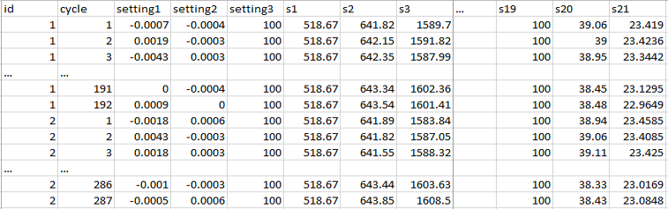
Feature Engineering
The process of creating features that provide better or additional predictive power to the learning algorithm.
a1 | a2 | … | a21 | sd1 | sd2 | … | sd21 | RUL | label1 | label2
60+ engineered features
Other potential features: change from initial value, velocity of change, frequency count over a predefined threshold
Notes:
Features are the input variables in your ML model.
Feature engineering: munging the data in such a way that we can taking input variables and creating extra variables and create a great ML model (i.e. aggregate rolling windows of sensor values – last week, or when it first started). So it’s creating values that are more predictive than the raw data.

Slide 18
Example Feature Engineering Methods
1- Rolling aggregates:
For each labelled record of an asset, pick a rolling window of size w, compute rolling aggregate features for the periods before the labelling date and time of that record.
Create features that capture degradation over time.
2- Lag features for short term:
For each labelled record of an asset, pick a window of size w and use tumbling windows to create aggregate features for the periods before the labelling date and time.
3- Lag features for long term:
For each labelled record, find aggregated features for a larger window than w reflecting the long term effects.
Notes:
Aggregate values (from raw being 1 sec to 1 hour level or day level) then do feature engineering, then do the prediction.

Slide 19
Modelling Techniques
BINARY CLASSIFICATION
REGRESSION
Predict failures within a future period of time
Predict remaining useful life, the amount of time before the next failure
MULTICLASS CLASSIFICATION
ANOMALY DETECTION
Predict failures with their causes within a future time period.
Predict remaining useful life within ranges of future periods
Identify change in normal trends to find anomalies
Notes:
Binary Classification: will the machine fail in the next 7 days (Y/N)
Regression Models (linear regression or boosted decision tree models) are used to predict use cases such as – What is the Remaining Useful Life? The amount of time before the next failure.
Multiclass Classification: are models where you may want to predict failures along with their causes. What is the root cause of this failure?
Or Predict Remaining Useful Life within ranges of future periods of time – next month and week.
Anomaly Detection: To identify trends or weird things that might be happening.
Not having to hard code thresholds for many different sensors.
This is very difficult to hard code thresholds when there are 100 different sensors and looking at each one.
Anomally detection is a method to learn what that threshold is and that can be ADAPTIVE over time.
Based on what I’ve seen in the past month, alert me if something odd occurs when something changes above that threshold. Maybe something weird is happening to that sensor.
In the azure marketplace, there is a anomaly detection API (so you can use it w/o having to build a model) available for uni-dimentional case: Stream of sensors
Multidirectional – take these 3 sensors over time and tell me what is different about them all 3 at once or how they changed

Slide 20
Data Labeling
id | cycle | … | RUL | label1 | label2
1 | 1 |  | 191 | 0 | 0
1 | 2 |  | 190 | 0 | 0
1 | 3 |  | 189 | 0 | 0
1 | 4 |  | 188 | 0 | 0
… |  |  | … | … | …
1 | 160 |  | 32 | 0 | 0
1 | 161 |  | 31 | 0 | 0
1 | 162 |  | 30 | 1 | 1
1 | 163 |  | 29 | 1 | 1
1 | 164 |  | 28 | 1 | 1
1 | 165 |  | 27 | 1 | 1
1 | 166 |  | 26 | 1 | 1
1 | 167 |  | 25 | 1 | 1
1 | 168 |  | 24 | 1 | 1
1 | 169 |  | 23 | 1 | 1
1 | 170 |  | 22 | 1 | 1
1 | 171 |  | 21 | 1 | 1
1 | 172 |  | 20 | 1 | 1
1 | 173 |  | 19 | 1 | 1
1 | 174 |  | 18 | 1 | 1
1 | 175 |  | 17 | 1 | 1
1 | 176 |  | 16 | 1 | 1
1 | 177 |  | 15 | 1 | 2
1 | 178 |  | 14 | 1 | 2
1 | 179 |  | 13 | 1 | 2
1 | 180 |  | 12 | 1 | 2
1 | 181 |  | 11 | 1 | 2
1 | 182 |  | 10 | 1 | 2
1 | 183 |  | 9 | 1 | 2
1 | 184 |  | 8 | 1 | 2
1 | 185 |  | 7 | 1 | 2
1 | 186 |  | 6 | 1 | 2
1 | 187 |  | 5 | 1 | 2
1 | 188 |  | 4 | 1 | 2
1 | 189 |  | 3 | 1 | 2
1 | 190 |  | 2 | 1 | 2
1 | 191 |  | 1 | 1 | 2
1 | 192 |  | 0 | 1 | 2
Predefined window size for classification models
w1 = 30
w0 = 15
Regression
Binary classification
w1
Multi-class classification
w0
Notes:
Simplistic methods:
Training data was Run-To-Failure data
Remaining Useful Life label is created by taking the max value of the cycles/flights. Which is flight 192 -1 = that’s how I label the model
Then I apply a regression type of technique
Binary classification- will it fail in the next 15 or 30 days
Or you can do survival analysis

Slide 21
ML Process
Historical Data
[features + labels]
Future Data
[features only]
Define Objective
Split
Training Data
[features + labels]
Testing Data
[features + labels]
Access and Understand the data
Train Model
[model learns from training data]
Score Model
[model predicts on future data]
*
Score Model
[model predicts on testing data]
Pre-processing
Prediction Results
Evaluate Model
[Compare predicted results and true labels]
*Depending largely on size/complexity, may want to do pre-processing and/or feature/target construction before ingesting into AML Studio / AML API.

Slide 22
“Most IoT data are not used currently…
the data that are used today are mostly for anomaly detection and control, not optimization and prediction, which provide the greatest value.”¹
Notes:
What do you want to do with the data in the future?
Think carefully about what data you are collecting and how it could be used in the future

Slide 23
Go Dos
Learn from Azure Machine Learning Gallery http://gallery.azureml.net (search “predictive maintenance”)

Slide 24
Acknowledgements
We utilized the following publically available data to help us generate realistic data for this pre-configured solution. We received assistance in creating this solution as a result of this repository and the donators of the data.
“A. Saxena and K. Goebel (2008). "PHM08 Challenge Data Set", NASA Ames Prognostics Data Repository (http://ti.arc.nasa.gov/project/prognostic-data-repository), NASA Ames Research Center, Moffett Field, CA.”
Quote on Slide 23: McKinskey Global Institute, The Internet of Things: Mapping the Value beyond the hype

